Slide 1
KLU Design Thinking for Innovation Project Title: Health care system Work In Progress Submission 1
Department : CSA Section : S6 Batch : J Date

Slide 2
Project Team - Introduction
S.NO | ID.NO | Name | Role in the project
1 | 2300520021 | Sk.Hafsa Tajmul. | Lead
2 | 2300520088 | T.Sathvika | Member
3 | 2300520079 | K.Gracy Benita | Member
4 | 2300530005 | SK. Nazma. | Member
5 | 2300560022 | P. Shalini Sowmya Sri. | Member
6 | 2300560052 | CH. Khyati Sindhura. | Member
7 | 2300560207 | G. Aparna. | Member
8 | 2300520193 | A.Apoorva Reddy. | Member
9 |  |  | Member
10 |  |  | Member
Trainer 1: R.PRADEEP KUMAR PATNAIK Trainer 2: RAJU VEERA VENKATAKA KALAVACHARLA

Slide 3
Rules to be followed
1. Provide hyper link wherever necessary
2. Zip all the documents and submit in the LMS submission link provided
3. The zipped document shouldn’t be more than 5MB
4. The presentation must be shared among all the teammates
5. Any queries on submissions may be clarified from respective section faculty (Trainer)

Slide 4
Project Identification : Submitted Together with this Report
Project template
(provide Group participation report for this portion of the project (format is provided in LMS)

Slide 5
Our Most Important Learnings
Provide introduction to your problem in one or two sentences for each of the following aspects of your project
Contextualization
here the context of our project is Time. There is a shortage of healthcare facilities, especially in rural areas, and many lack
essential equipments and resources. There is also a shortage of hospital beds and specialized
faculty
Sustainable goals
Providing proper treatment on time
Having proper requirments
Mobile hospitality
Story behind the problem selection (motivation)
We see many accidents that happens on highways but no one comes to rescue them on time till they die so our motivation and aim is to provide ambulance on time with proper epquiments and on time treatment in the ambulace itself.
Express each sentence as a short, simple sentence, not a long explanation.

Slide 6
Empathy : Submitted Together with this Report
Stake holders and power interest matrix
Interview protocols for all target groups
Interview reports for all Interviews (at least 25)
One-drive Link of your empathetic interview recordings (at least 25)
Persona for important stake holders (at least two)
Group participation report for this portion of the project (Empathy and Define)

Slide 7
Power – Interest Matrix
High Power – Low Interest
High Power – High Interest
Keep Satisfied
Manage Closely
Important Stakeholder 1
Type Stake holders
Type Stake holders
Important Stakeholder II
POWER
Monitor with Minimum Effort
Keep Informed
Type Stake holders
Type Stake holders
Low Power – Low Interest
Low Power – High Interest
INTEREST

Slide 8
Interview Protocol
I need to know (thoughts, feelings, actions) | Questions I will ask (open questions) | Insights I hope to gain
thoughts | How does sitting on the floor affect your ability to concentrate and learn? | The impact of floor seating on learning.
 | Can you describe the challenges or limitations of sitting on the floor from a practical standpoint? | Students perceptions of the practical challenges of floor seating.
Feeling | How do you feel about sitting on the floor during lessons? | Feelings of comfort or discomfort.
 | What emotions or thoughts come to mind when you think about having proper desks and chairs in the classroom? | Students' emotions and thoughts about potential improvements.
Actions | How you are doing class work on floor for continuously 2 to 3 hours? | Actions presently done
 | Have you taken any actions or spoken to anyone about your concerns regarding sitting on the floor? | Proactive actions and advocacy efforts.

Slide 9
Interview Report (Best 5 only in this slide)
Interview Description
User/Customer | Questions Asked | Insights gained (NOT THEIR ANSWERS)
Abhishek Verma | Can you describe the challenges or limitations of sitting on the floor from a practical standpoint? | Students doing work continuously on the floor suffering with back pain

Slide 10
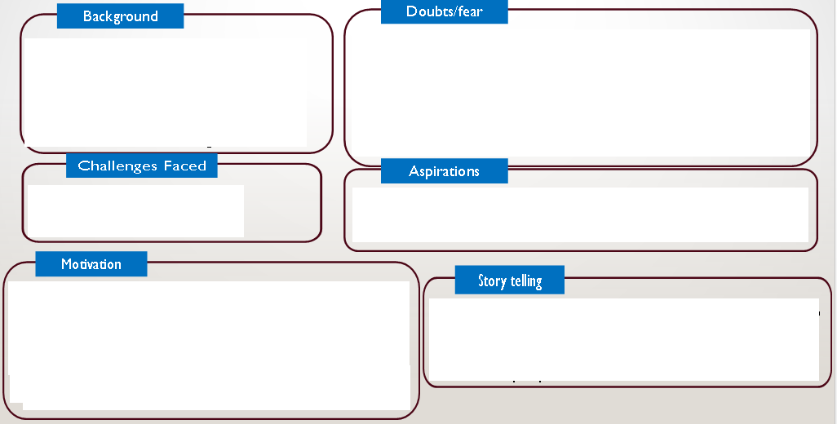
PERSONA
What are the doubts/fears faced by the individual
Family background, education, childhood
Challenges faced by the person is dealing with his stakeholder
What this individual aspires to be/vision
What motivates the individual
Construct a story while explaining the person to your peers and document the insights…

Slide 11
. Our Most Important Learnings
Type your most important three things you learned on this slide.
List out the Insights gained in the Empathetic Research as Fact/Evidence based statements Examples:
1. People do not have an access for clean water (need filter water to drink).
2. Children doing work continuously sitting on the floor suffering with back pain
(need a portable table).
Express each thing you learned as a short, simple sentence, not a long explanation. Under each insight, type no more than two lines to tell whether it came from observe, engage (interviews) and immerse, and why you think it is important. Example: In video observe that People walk 4 miles and water contain dirt, sticks, leaves/plants, sand, gravel unable to drink. This is important because our solution will have to fit with what these children already do and like.

Slide 12
Other Things We Learned
List additional learnings on this page. You can type just the statements. You do not need to add anything underneath the statements. You do not need to state the source. You do not need to explain these learnings. (Optional)

Slide 13
Things we Saw and Heard (Key Observations)
On this slide, type word-for-word some of the important things that people said during interviews.
Enclose their words in quotation marks (inverted commas: “ ”)
Also type some of the important actions you observe people do in the empathy research
You may continue listing evidence on the next slide if you wish

Slide 14
Define : Submitted Together with this Report
Provide a Customer Journey Maps for your potential user
Five why questions and identify the cause-effect and root cause of the problem
One form with 10 PoV Statements and questions
Define your problem statement (A simple understanding, actionable and meaningful statement)

Slide 15
Customer Journey Map
Provide a customer journey map for a particular persona
Provide description in one or two lines here:

Slide 16
END

